Slide 1
Lecture 9 – System Reliability
Notes:
Reliability is one of the most important attributes of systems. Being able to make calculations at a system level is one of the most important skills that a systems engineer can bring to a project. Being able to calculate system level reliability to make trade selections among different systems configurations is a big contribution that systems engineers can make to a system design.

Slide 2
Overview
What is reliability ?
What is MTBF ?
How do you calculate reliability from MTBF ?
Accelerated testing & Historical analogy
How do you combine reliability of components
  In parallel
  In series
Reducing a complex system
Using reliability to drive system design
Traditional assumed reliability=1 components
These topics are important for the Fundamentals of Engineering (FE) and Professional Engineer (PE) examination

Slide 3
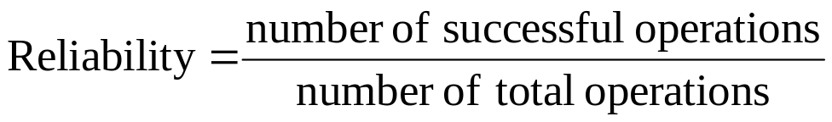
What is Reliability ?
Reliability is the probability that a system will successfully complete its function
Probability of Failure = 1-Reliability
If you can observe a system for a sufficiently large number of operations you can directly compute reliability
  To get statistical significance would have to observe the system long enough for many failures to occur
    30 occurrences is a good working rule of thumb
This is hard to do in complex systems with many components because you have to observe all of the components failing
particularly difficult if they are in some redundant arrangement and you have to observe multiple failures or combinations of failures
Better approach is to compute the reliability from the mean time between failure (MTBF) for each components and combine them to form a system reliability

Slide 4
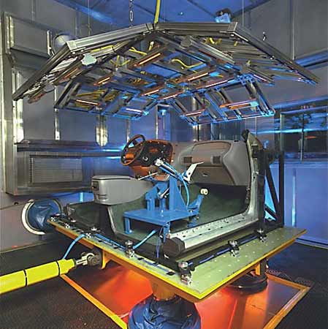
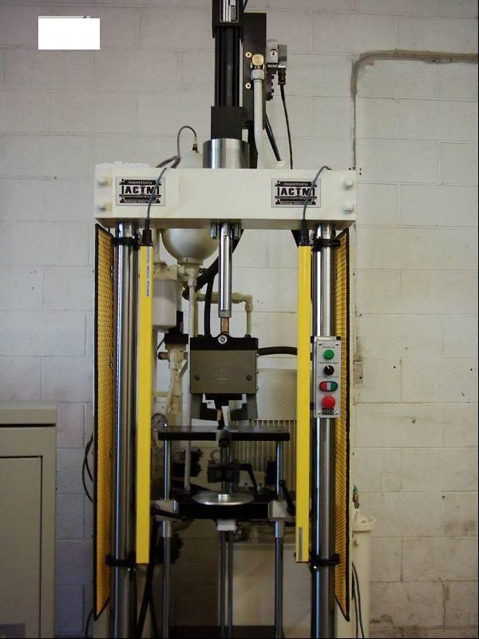
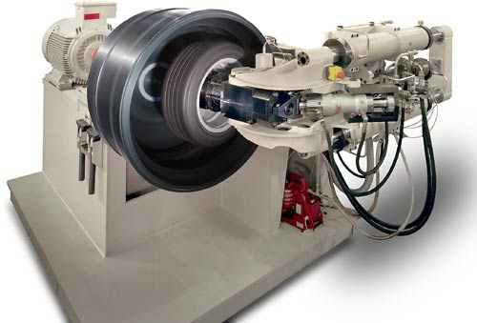
MTBF
MTBF is the Mean Time Between Failure
Relatively easy to determine on a component basis based on test for components that are run continuously or for fixed periods of time
  Best to perform multiple tests and get a significant number of failures to get a distribution
  Compute a mean and standard deviation (sigma)
From this type of test we can determine a failure rate per number of hours of operation
Tire/Road simulator tester
Shock absorber tester
Multi-Axis Load Tester
http://www.actminc.com/products/Machines.html

Slide 5
Accelerated Testing and Historical Analogy
What if
  You are early in design and components haven’t been built yet ?
  You can’t afford to wait around to accumulate failure data ?
  You don’t have enough components to test
You can perform accelerated life testing
  For electronics this is performed at high temperature
    MIL-SPEC 810 describes tests
    Good overview at www.weibull.com
    Mil-HBK 217 has models for predicting electronics failure based on Parts Stress Analysis and Parts Count Analysis
  Historically Accelerated Life Testing (HALT) is an extreme test to determine weakest part of design
  Highly Accelerated Stress Screening (HASS) or Environmental Stress Screening (ESS) is a less rigorous environmental test used to screen every production part
You can use historical reliabilities for like components
  NASA has a database
  Aerospace Corp has a database
  Various published articles

Slide 6
MIL HBK 217 Prediction Model
Typical MIL-217 Failure Rate Model
A sample MIL-217 failure rate model for a simple semiconductor component is shown below. Many components, especially microcircuits, have significantly different and more complex models.
Failure rate = pib * piT * piA * piR * piS * piC * piQ * piE Failures/million Hours
Where:
piT = Temperature factor
piA = Application factor (linear, switching, etc)
piR = Power rating factor
piS = Electrical (voltage) Stress factor
piC = Contact construction factor
piQ = Quality factor
piE = Operating environment factor
The above listed pi factors are based on a simple component and are shown for example. There are also pi factors for items such as learning factor, die complexity factor, manufacturing process factor, device complexity factor, programming cycles factor, package type factor, etc. Each component or part group and it's associated subgroup has a base failure rate plus numerous pi factor tables, unique to that component or part, that list factors that are used in the model to adjust the base failure rate.
http://www.reliabilityeducation.com/intro_mil217.html
Notes:
“Military Handbook; Reliability Prediction of Electronic Equipment”, MIL-HDBK-217F Notice 2 dated December 2, 1991 developed by Rome Laboratories, and the United States Department of Defense. The purpose for developing this handbook was to establish and maintain consistent and uniform methods for estimating the inherent reliability of military electronic equipment and systems. The handbook is intended as a guideline, not a specific requirement, to increase the reliability of equipment being designed. (http://www.reliabilityeducation.com/intro_mil217.html)

Slide 7
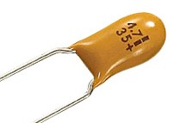
MIL 217 Stress Example
A solid tantalum fixed electrolytic capacitor, for example, has a MIL-217 model as follows:
Failure rate = pib * piCV * piSR * piQ * piE Failures/million Hours
Where:
piCV = Base failure rate for component
piSR = Series resistance factor
piQ = Quality factor (quality levels of D, C, S, B, R, P, M, L, Lower)
piE = Environment factor
MIL-217 has models for
  Microcircuits
  Discrete semi-conductors
  Tubes
  Lasers
  Resistors
  Capacitors
  Inductive devcices
  Rotating devices (motors)
  Relays
  Switches
  Connectors
  Interconnection assemblies
  Meters, Quartz crystals, Lamps, fuses
http://www.reliabilityeducation.com/intro_mil217.html

Slide 8
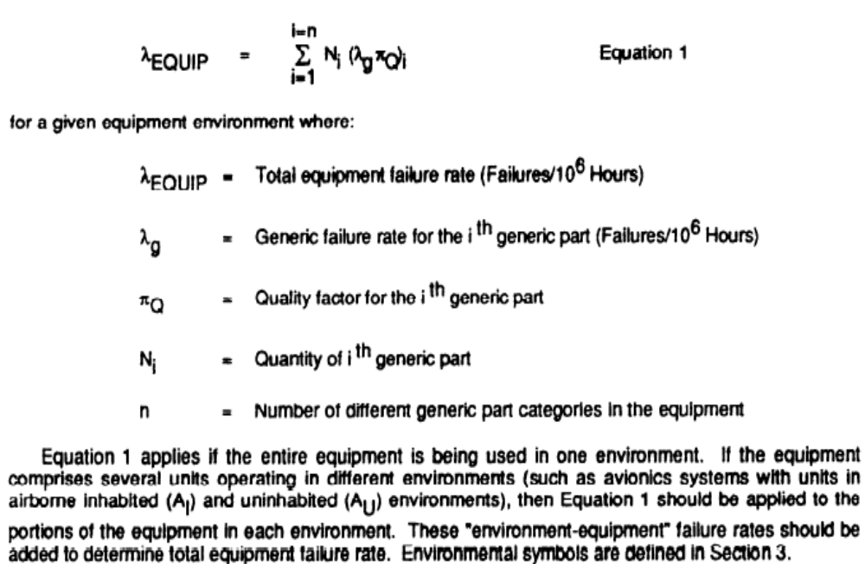
MIL 217 Parts Count Analysis from MIL HBK 217
Notes:
The importance of this equation is in estimating total electronics assembly reliability when you don’t know the details of the physical arrangement yet. In this case, when you don’t know if parts are in serial or parallel arrangement or even how the parts work, if you can make an estimate of the total number of parts , then you can make a reliability estimate .
The total failure rate is the sum of a set of products.
The products include individual part rates, the quality of the parts and the quantity of the parts. The quality of the parts factor is necessary because the failure rate, lambda, assumes perfectly manufactured, assembled and installed components. The quality factor accounts for errors or problems in materials, manufacturing, assembly and installation.

Slide 9
Example of Historical databases – Launch vehicle failures by vehicle and subsystem
Launch Vehicle Subsystem Failures, 1980–1999
Country | Propulsion | Avionics | Separation | Electrical | Structural | Other | Unknown | Total
U.S. | 15 | 4 | 8 | 1 | 1 | 1 |  | 30
CIS/USSR | 33 | 3 | 2 |  |  | 1 | 19 | 58
Europe | 7 | 1 |  |  |  |  |  | 8
China | 3 | 1 |  |  | 2 |  |  | 6
Japan | 2 | 1 |  |  |  |  |  | 3
India | 1 | 1 | 1 | 1 |  | 1 |  | 5
Israel | 1 |  |  |  |  |  |  | 1
Brazil | 2 |  |  |  |  |  |  | 2
N. Korea |  |  |  |  |  |  | 1 | 1
Total | 64 | 11 | 11 | 2 | 3 | 3 | 20 | 114
http://www.aero.org/publications/crosslink/winter2001/03.html
Notes:
The website contains an interesting analysis of launch vehicle failures. It is interesting to see the distribution of failures by system. Propulsion system failures dominate.

Slide 10
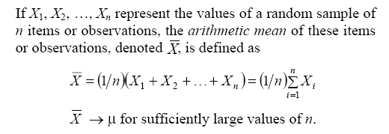
Mean

Slide 11
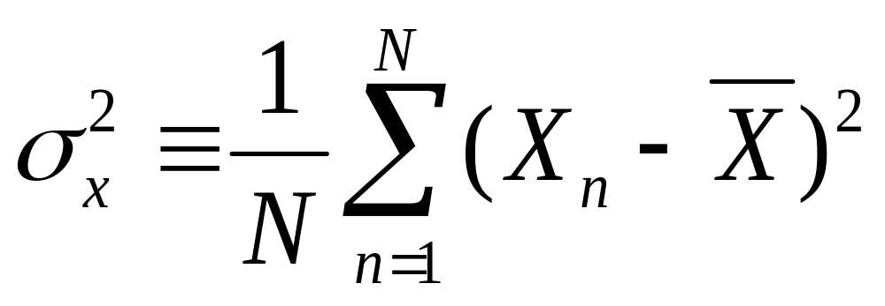
Variance of a population
The standard deviation is the square root of the variance

Slide 12
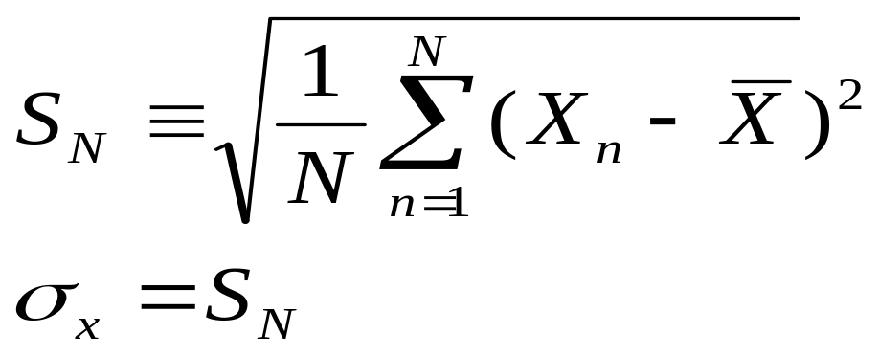
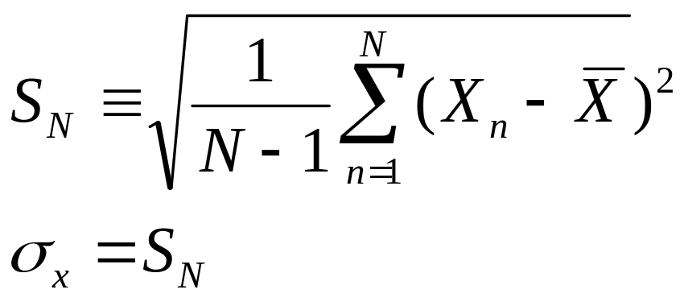
Standard Deviation
The standard deviation of a population is defined as
This is the equation to use if you have 100 percent sampled the entire population
The standard deviation of a sample is defined as
This is the equation to use if you are dealing with a sample of the population and trying to estimate the entire population’s characteristics
Use with failure test data

Slide 13
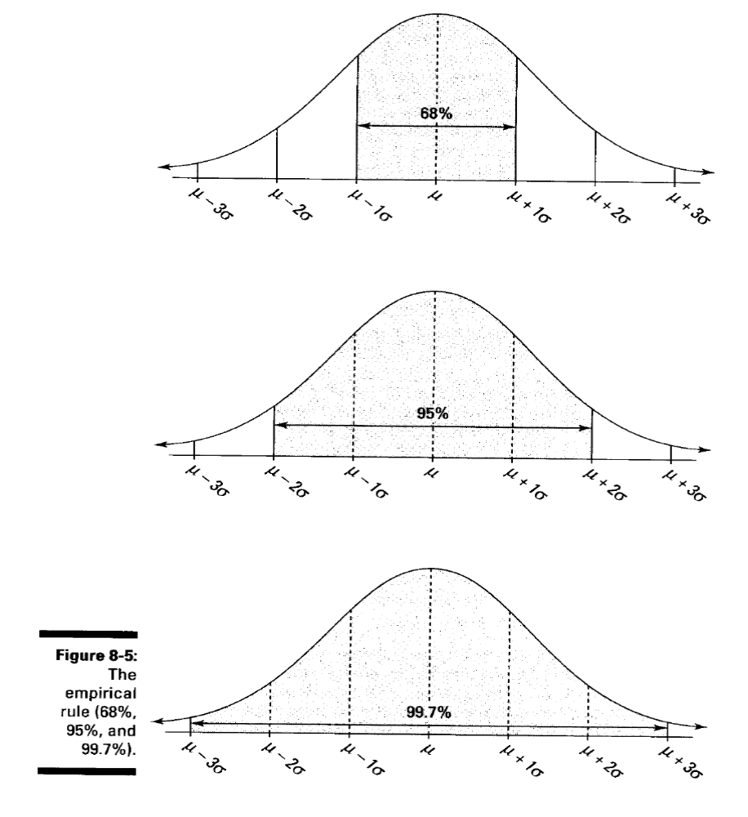
From “Statistics For Dummies”by Deborah Rumsey”
Caution – these probabilities are for normal distributions only. Not all data fits a normal distribution. It may be log-normal, exponential, etc…which have different interpretations.

Slide 14
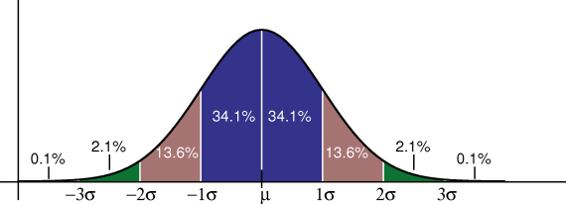
Standard Deviations In A Normal Distribution
The probability of a value being between mean plus 3 sigma and mean minus 3 sigma in a normal distribution is 99.6%
Note – This is two sided – can vary the same on either side of the mean – not all populations of data are two sided
Source: Wikipedia

Slide 15
We can choose
To compute the mean failure rate based on the
  mean observed failure rate
  Mean observed failure rate + 1 sigma
  Mean observed failure rate + 2 sigma
  Mean observed failure rate + 3 sigma – most conservative

Slide 16
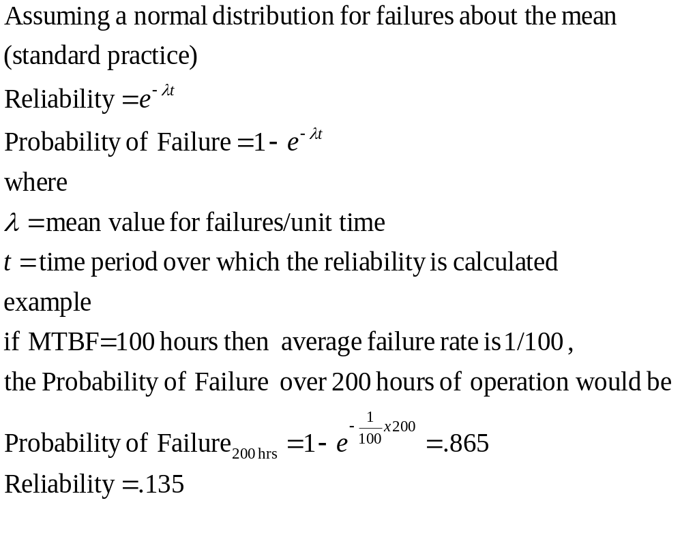
MTBF to Reliability

Slide 17
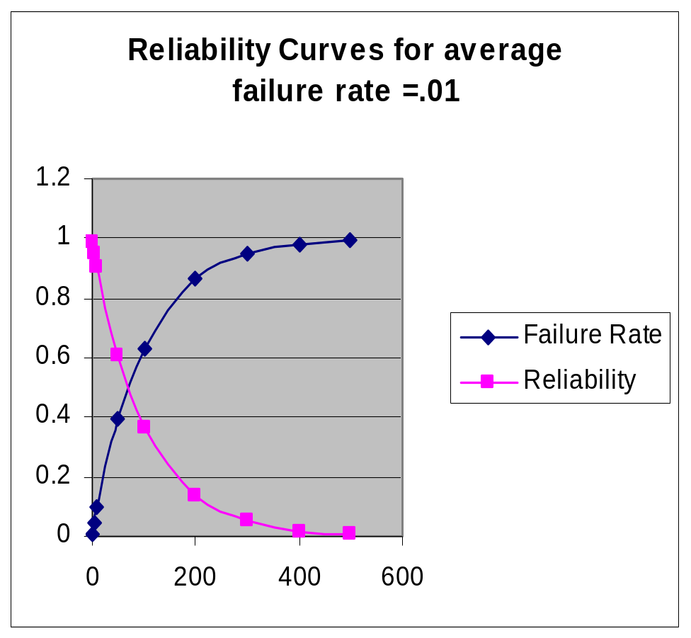
Behavior of Reliability and Failure Rate over Time
Specified Failure Rate | Time | Probability of failure | Reliability
0.01 | 1 | 0.009950166 | 0.99005
0.01 | 5 | 0.048770575 | 0.951229
0.01 | 10 | 0.095162582 | 0.904837
0.01 | 50 | 0.39346934 | 0.606531
0.01 | 100 | 0.632120559 | 0.367879
0.01 | 200 | 0.864664717 | 0.135335
0.01 | 300 | 0.950212932 | 0.049787
0.01 | 400 | 0.981684361 | 0.018316
0.01 | 500 | 0.993262053 | 0.006738
Notes:
Probability of failure is a function of failure rate and time. As time of operation increases , the probability of failure increases.

Slide 18
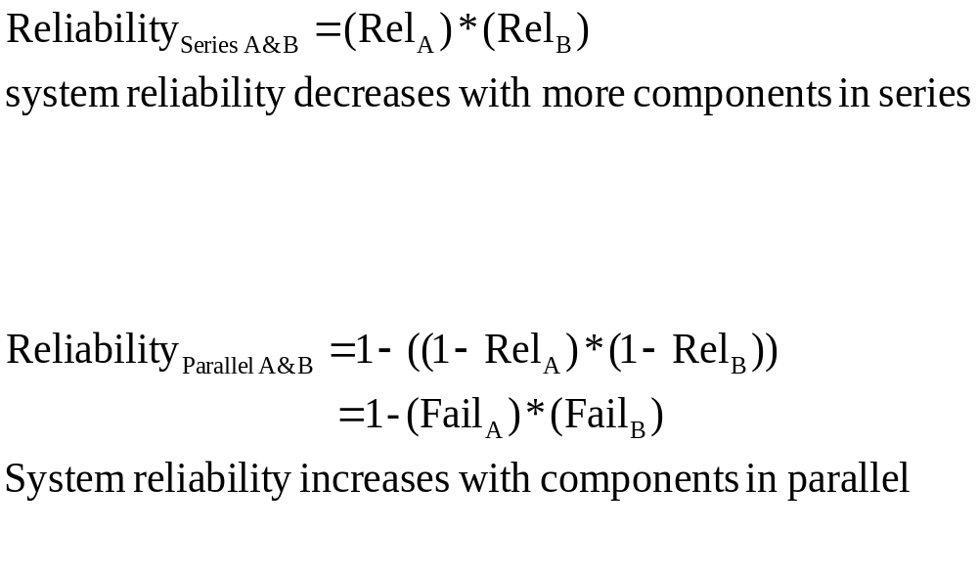
Parallel versus Series
A
B
A
B

Slide 19
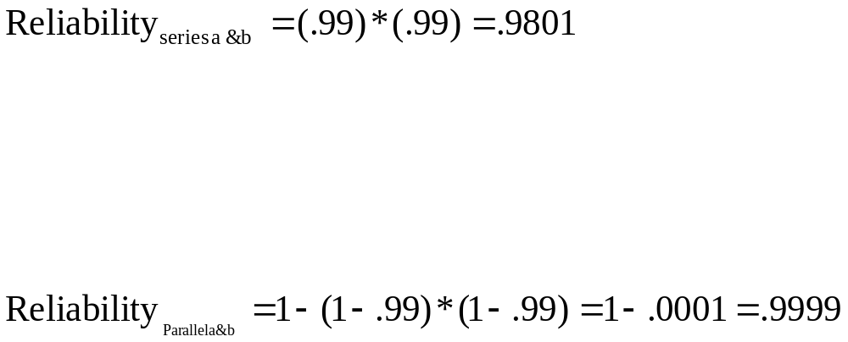
Parallel versus Series - Example
.99
.99
.99
.99

Slide 20
To calculate reliability of more complex systems
Reduce the system
Combine all series elements by multiplying the reliabilities
Combine parallel elements by 1-(product of the failure rates)
Keep repeating the process until reduced to a single block

Slide 21
Example System Reduction
B
E
.80
.80
A
D
.99
.99
C
F
.80
.80
To reduce
Combine B and C (1-(1-.8)(1-.8))=.96
Combine E and F = .96
.99
.96
.99
.96
A
BC
D
EF
Combine remaining in series
= A*BC*D*EF=.99*.96*.99*.96= .903

Slide 22
Using reliability as a driver in system design
Reliability may be a driver in system design in several ways
  You may decide to add redundancy to components that drive system reliability low
  You may add redundant systems where component redundancy is not enough
  You may choose to design for maintenance or repair of lower reliability components
  You may architect the system to fail safe on failures of lower reliability components

Slide 23
Component Versus
System Redundancy
Pump
Evap
Example - a coolant system
Load
Pump A
Evap
Pump A
Evap A
System A
Pump B
Load
System B
Pump B
Evap B
Load
Component Redundancy
System Redundancy
Notes:
Here are some cooling system examples on redundancy. The basic system consists of a fluid loop that provides cooling by flowing liquid. The loop consists of pump, which moves the fluid, the evaporator, which cools the fluid, and the load which is the active heat source that the fluid cools.
In component redundancy, you add additional copies of the same component to increase redundancy. Typically this is done where one component has significantly lower reliability than the rest of the components or where one component is more active than others. Fore example in the component redundancy example, the pump has moving parts, versus the evaporator or load which are flow-thru devices.
In system redundancy, you add a complete second system so that the load can be cooled by either loop or possibly by both loops simultaneously. In this way for example if the system A loop springs a leak, then the system B loop can continue to run unaffected. Contrast that to the component redundancy where if the loop springs a leak, that the redundancy in the pumps cannot save the system.

Slide 24
 | Pro’s | Con’s
Component Redundancy | Lowest Cost, weight Lowest System Impact Best when one component has a significantly higher failure rate than other components | Does not provide full coverage
System Redundancy | Best possible coverage | Highest Cost, weight Highest System impact May not achieve full effect if common mode failures in supporting systems (power, instrumentation) or subject to a common failure location (single failure takes out both systems – Apollo 13)

Slide 25
Assumed Reliability=1.0
It is not uncommon to assume certain types of systems and devices are reliability = 1.0 i.e. they are assumed to never fail. Typical systems and their rationale are:
Primary and Secondary Structure – rationale is design/analysis/test demonstrating design capacity above design limit load*factor of safety
  This is also called “Design For Minimum Risk or DFMR”
Pyrotechnic devices such as stage separation mechanisms in launch vehicle, ejection seats in aircraft or automobile airbag deployments– when properly designed these devices essentially never fail
  Requires testing to establish minimum energy to initiate the device and then demonstrating factor of safety above that in initiating devices
  Initiating systems (electrical circuits that fire the initiators) typically have reliability less than one and are the most common failure source in pyrotechnics

Slide 26
Margin
Design Capability exceeds requirements
Factor of Safety
Design Capability does not meet requirements
Design Limit Load
Relationship between Design Limit Load, Design Capability, Factor of Safety and Design Margin

Slide 27
Reliability =1 continued
Pressure Vessels and plumbing – when designed/tested/analyzed to a factor of safety (typically 4) above the design limit load. Fatigue/fracture must also be tracked due to pressure cycles
Fittings or joints as well as active components such as valves can have reliability associated with leakage, blockage or fail to function
Wiring –
  when properly installed with
    protection against mechanical damage
    derated for current and numbers of wires in a bundle
    fusing/circuit breakers to prevent shorts in loads from stressing the insulation system
  Often wiring is tested with high potential (HiPot) around 500V placed across the wire to find any breakdowns in insulation
  HiPotTests can occur prior to and sometimes after installation. Such testing must be carefully performed to have enough isolation to avoid paths that overstress other electrical equipment

Slide 28
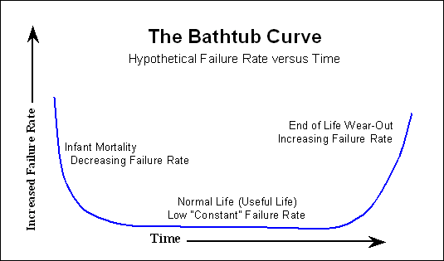
Notes:
This is just a reminder on the fact that failure rates change based on the age of the components. Reliability of many types of hardware, particularly electronics, follows the bathtub model. Products with systematic flaws, i.e. they don’t work properly, are usually identified early. Weak materials are also usually identified in the first few cycles of use. In electronics, parts usually fail in the first few times they are exposed to warmer operating temperatures for the first time as heating expands materials and weak spots of breaks in materials are exposed, opening up circuits. Once the product has been exposed to multiple heating and cooling cycles, these weak or broken parts have been exposed or fail due to metal fatigue.
Once through this period of “infant mortality” most electronics components can run for years without problems. To avoid these “infant failures” after delivering products, it is often very effective to burn-in electronics – or run them through multiple periods of extended on-off cycling, to reveal the weak components .
Failure rate starts to build up at the end of life as components fatigue through their useful life. The rise in failures is usually due to the probabilistic scatter inherent in fatigue processes.
CLASS Activity: (if you didn’t do it in lecture 5) To understand probabilistic scatter in metal fatigue, hand every student a paper clip and have them bend it back and forth, counting the number of times until it breaks, Plot the number of failures versus the number of cycles.

Slide 29
Any Questions ?

